Slide 1
Sentiment analysis across Reddit posts
Insights into community reactions
ANTON ANDREI ALEXANDRU
DOLGANIUC ANA
407 AI

Slide 2
INTRODUCTION
Reddit is a rich source of diverse user-generated content with unique subreddits, each having its own norms and language. Analyzing sentiment on Reddit helps in understanding community reactions, emotions, and the tone of discussions. The purpose of the project is to develop a sentiment analysis pipeline to analyze sentiment across various subreddits. Useful for community managers, marketers, and researchers to gain insights into online discourse.

Slide 3
Objectives & Significance
Objectives:
Determine general sentiment (positive, negative, neutral) across subreddits.
Identify trends and emotional responses in specific communities over time.
Significance:
Diverse Opinions: Reddit's vast range of topics offers varied public opinions.
Complexity: Informal language and cultural references on Reddit present challenges.
Impact: Helps improve community health and informs business strategies.

Slide 4
What will be covered
1
2
3
4
5
The multi-model approach using both RoBERTa and VADER models for sentiment classification.
The data collection and preprocessing methods employed to handle Reddit’s unstructured data.
The sentiment aggregation techniques used to derive meaningful insights from individual comments.
The evaluation of the pipeline's performance on different subreddits and discussion of key findings.
The challenges faced, limitations of the current approach, and potential avenues for future improvements.

Slide 5
Challenges & Applications
Challenges
Applications
Subreddit Diversity: Each subreddit’s language and tone vary widely.
Complex Language: Informal language, memes, and sarcasm require advanced sentiment models.
Comment Variability: Comments range from short to long, often containing mixed sentiments.
Politics: Gauge public opinion around elections and political events.
Brand Management: Monitor and manage online reputation.
Public Health: Detect mental health issues through sentiment trends.
Content Moderation: Flag toxic or harmful content to ensure community safety.

Slide 6
Sentiment analysis pipeline overview
Purpose:
Capture sentiment from Reddit comments across diverse subreddits.
Provide insights into the overall tone of discussions.

Slide 7
Data collection
Reddit Scraping Strategy
Tools and Techniques Used
Preprocessing of Data
Scrape top 10 hottest posts with at least 10 comments.​
Use Reddit API (PRAW) for efficient data retrieval.
Clean text: Remove HTML tags, URLs, special characters.
Sentence splitting for granular analysis.

Slide 8
Sentiment Analysis Approach
Multi-Model Approach:
Sentiment Aggregation:
Aggregate sentence-level to comment-level.
Comment-level to subreddit-level:
Mean sentiment score.
Sentiment distribution analysis.
Temporal sentiment trends.
RoBERTa Model:
Transformer-based, fine-tuned on Twitter data.
Captures nuanced sentiments and social media context.
VADER Model:
Rule-based, tailored for social media.
Effective for explicit sentiment in short text.
Combining Outputs:
Use highest confidence score from either model.
RoBERTa for nuanced sentiment, VADER for straightforward cases

Slide 9
Validation & Results
Validation:
Tested across 10 subreddits with diverse sentiment profiles.
Evaluation Metrics: Precision, Recall, F1-Score, Accuracy. Compare against human-labeled data for reliability. Perform error analysis to refine models.
Key Results:
Positive sentiment in subreddits like "r/cats" and "r/formula1."
Neutral sentiment presents a challenge for refinement.
Model disagreements highlight areas for improvement.

Slide 10





Workflow summary
Step 1
Step 2
Step 3
Step 4
Step 5
Data collection
Scrape and preprocess comments.
Sentiment Analysis
Multi-model (RoBERTa and VADER).
Aggregation
From sentence to subreddit-level.
Validation
Test and refine the pipeline.
Evaluation
Test and refine the pipeline.

Slide 11
Key findings

Slide 12
Overview of results
Subreddits Analyzed
Overview
Insights
Positive: r/cats, r/formula1,
Mixed (Leaning Negative): r/gaming, r/relationshipsNegative: r/mildlyinfuriating
r/taylorswiftMixed
Neutral to Negative: r/NosleepNeutral: r/nostupidquestionsMixed: r/oldpeoplefacebook
Analysis covered 10 subreddits with varying sentiment profiles.
Sentiment distribution helped understand the tone of discussions:
Positive: Emotions like joy, amusement, support.
Negative: Frustration, irritation, negative feedback.
Neutral: Factual, non-emotional content, critiques.
Subreddits with focused content (e.g., r/cats, r/formula1) generally had more positive sentiment.
Communities with diverse or contentious topics (e.g., r/gaming, r/relationships) showed mixed or negative sentiment.

Slide 13
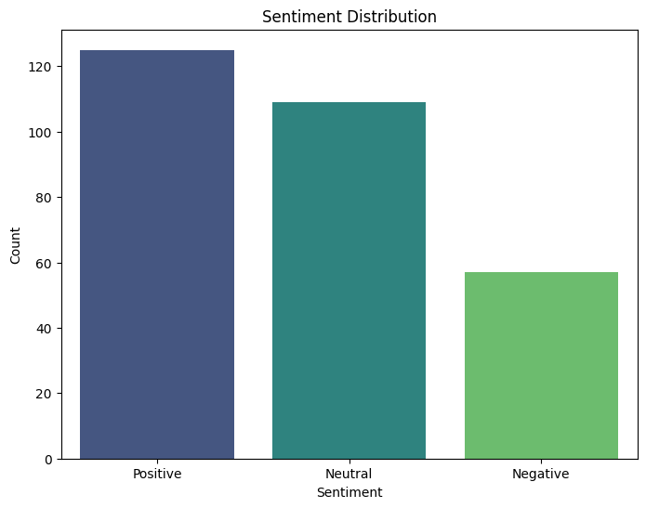
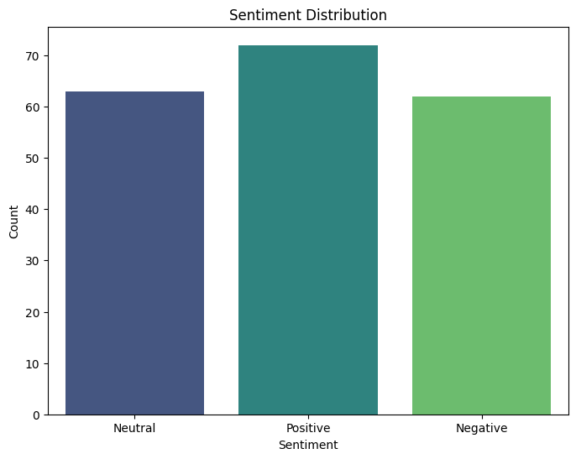
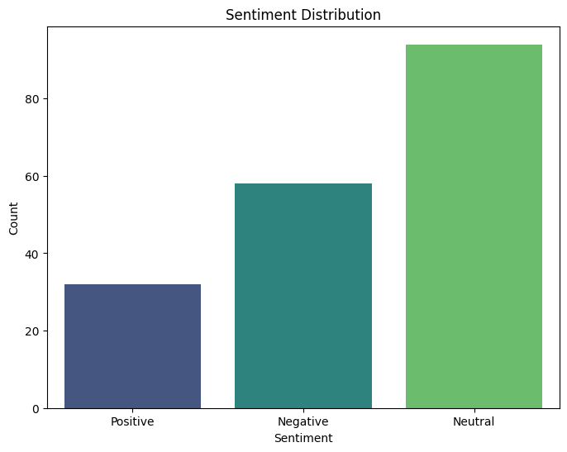
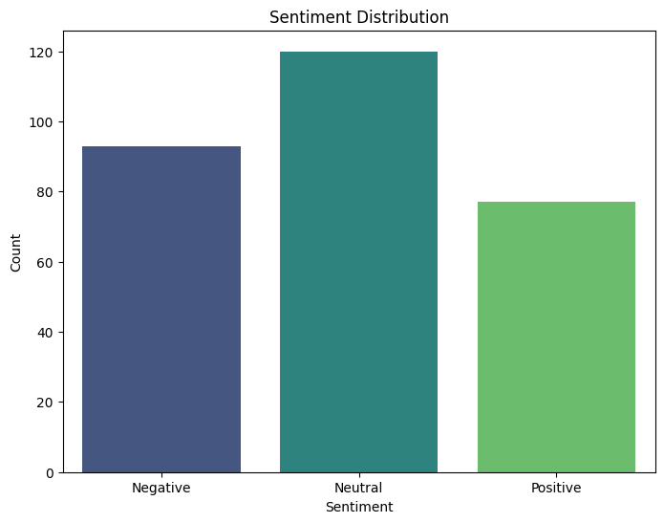
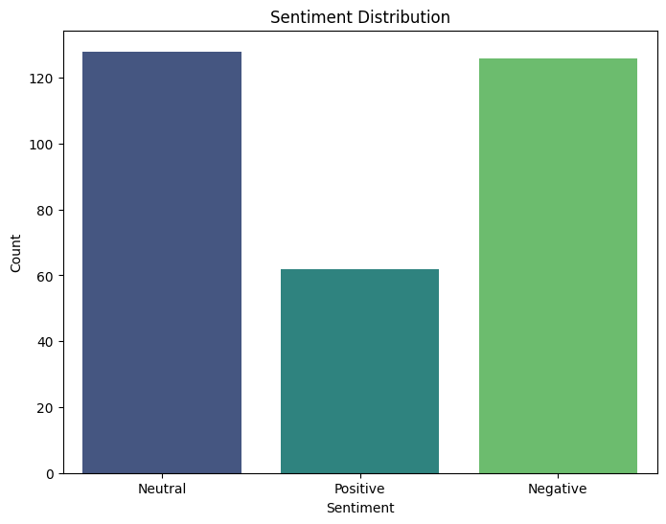
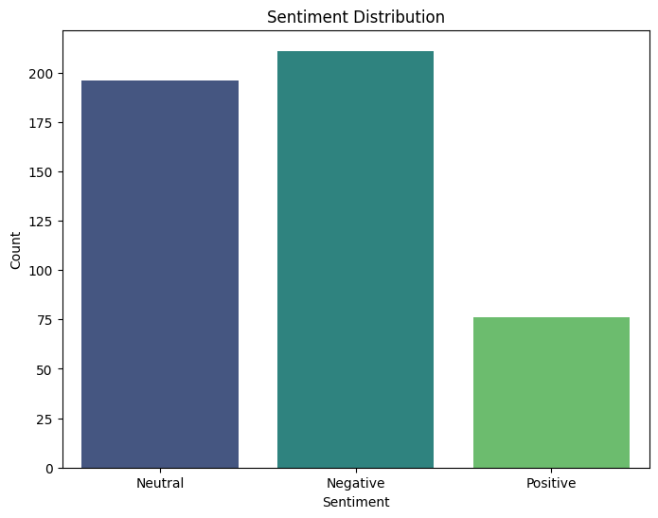
r/Cats
r/Formula1
r/Funny
r/Gaming
r/Nostupidquestions
r/Relationships

Slide 14
Observations
Positive-Dominant:
r/cats, r/formula1:** High positive sentiment; communities are supportive and enthusiastic.
Neutral-Predominant:
r/funny, r/mildlyinfuriating:Neutral sentiment dominates; some negative responses reflect mild disapproval or irritation.
Balanced Sentiment:
r/gaming, r/nosleep: Equal mix of positive, negative, and neutral sentiments; factual or informative discussions.
Neutral/Negative Dominance:
r/nostupidquestions, r/oldpeoplefacebook:Predominantly neutral with secondary negative sentiment; minimal positive engagement.
High Negative Sentiment:
r/relationships, r/taylorswift: High neutral and negative sentiment; reflects emotionally charged or controversial topics.
High Neutral Sentiment Across Subreddits:
Suggests many discussions are factual or non-emotional.
Reflects possible limitations in detecting subtle emotional cues like sarcasm.

Slide 15
Challenges, Limitations & Summary of Findings
Challenges and Limitations
Summary of Findings:
Neutral Sentiment Classification:
High volume of neutral sentiment; may reflect limitations in capturing subtle emotional tones.
Model Disagreements:
RoBERTa and VADER models sometimes disagree; requires further refinement for better accuracy.
Complex Language Constructs:
Struggles with detecting sarcasm, irony, and indirect sentiment common on Reddit.
Broad Insights:
Pipeline effectively captures sentiment trends, distinguishing positive from negative communities.
Areas for Improvement:
High neutral classifications and model discrepancies suggest need for refinement.
Potential:
Valuable tool for understanding community sentiment, identifying toxic communities, and aiding content moderation.

Slide 16
Challenges and limitations

Slide 17
High Neutral Sentiment
Challenge: High volume of neutral comments reduces nuanced insights.
Explanation: May represent factual statements or limitations in capturing subtle emotional tones (e.g., sarcasm).
Potential Solutions:Fine-tune models on Reddit-specific data.Incorporate models for sarcasm and subtle expressions.Use weighted adjustments to reduce neutral bias.

Slide 18
Model Disagreement
Challenge: RoBERTa and VADER sometimes disagree on sentiment classification.
Explanation: RoBERTa may overfit to Twitter data; VADER lacks contextual understanding.
Potential Solutions: Refine the ensemble method to balance model strengths.Implement feedback loops for continuous learning.

Slide 19
Handling Sarcasm & Complex Language
Challenge: Pipeline struggles with sarcasm, irony, and indirect sentiment.
Explanation: Both models have limitations in recognizing complex expressions.
Potential Solutions:Develop a specialized sarcasm/irony detector.Enhance contextual understanding with additional data (e.g., comment history).

Slide 20
Generalization Issues Due to Training Data
Challenge: RoBERTa fine-tuned on Twitter data may not generalize well to Reddit.
Explanation: Reddit's language and community norms differ from Twitter’s.
Potential Solutions:
Fine-tune on Reddit-specific data.
Apply transfer learning to adapt models to Reddit’s context.

Slide 21
Computational Complexity
Challenge: RoBERTa's resource demands affect scalability and real-time processing.
Explanation: High computational power is required for large-scale sentiment analysis.
Potential Solutions:
Explore model compression techniques (e.g., pruning, quantization).
Implement a two-tiered approach with lightweight models for initial filtering.
Utilize parallel processing and distributed computing for efficiency.

Slide 22
Summary of Challenges & Potential Improvements
Focus Areas:
Model refinement and domain-specific training.
Improving computational efficiency.
Enhancing detection of sarcasm and complex language.
Goal: Make the pipeline more adaptable to Reddit's unique characteristics for accurate sentiment insights.

Slide 23
SUMMARY
Promising Results: The sentiment analysis pipeline effectively captures broad sentiment trends across Reddit communities, distinguishing positive, neutral, and negative tones.
Challenges Identified: High Neutral Sentiment which reduces nuanced insights; fine-tuning needed for Reddit-specific data.
Model Disagreements: RoBERTa and VADER show discrepancies; refining ensemble methods can improve accuracy.
Sarcasm & Complex Language: Difficulty detecting irony and sarcasm; requires specialized models and better context understanding.
Computational Complexity: RoBERTa's resource demands hinder scalability; model optimization and lightweight filtering strategies are key.
Future Improvements: Incorporating sarcasm detection models, refining sentiment analysis methods, and improving computational efficiency will enhance the pipeline’s reliability and adaptability to Reddit’s unique linguistic and cultural environment.

